Slide 1
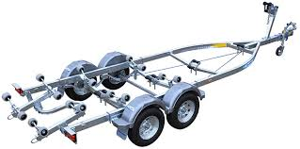
MOTORBOAT TRAINING, TESTING & LICENSING
Presenter:
Title: Trailers, Maintenance and Trailering
Manual – TAB 3
Date:

Slide 2
Trailers, Maintenance and Trailering
Objectives:
List required equipment for safe trailering
List safe trailering practices
List normal maintenance procedures for trailers

Slide 3
Trailering
Most recreational boats in the US are trailered to and from the water.
Boating package:
Boat
Trailer
Hitch
Towing Vehicle

Slide 4
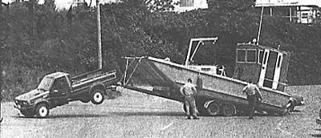
Boat/Trailer
If possible, purchase the boat and trailer as a package from the manufacturer.
Trailer should be designed to carry the total weight of the hull, engine, equipment and any extra gear normally carried.
Manufacturer’s capacity plate (never exceed 85% of total capacity).
Notes:
1. Check the manufacturer’s specifications, which are on a plate attached to the trailer. If the weight of the boat and its engine is more than 85% of the recommended load capacity, buy the next larger trailer. This is because your gear (fuel, PFD’s, anchors, lines, etc.) will increase the overall weight by at least 10%.
2. Trailers are classified by the maximum amount they may weigh when fully loaded.
Gross Vehicle Weight Rating
Class 1 - <2000 lbs. Class 2 - 2001 to 3500 lbs. Class 3 - 3501 to 5000 lbs. Class 4 - > 5000 lbs.
B. Load height. Ensure that the boat is properly loaded onto the trailer to keep the center of gravity as low as possible. Extended mirrors on the towing vehicle may be necessary to ensure good visibility around and over the vessel. The height of the load will affect how easy the vessel is to launch and retrieve.

Slide 5
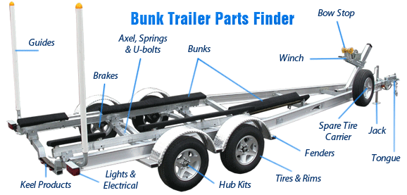
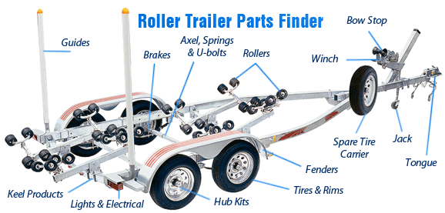
Trailer Types
Bunk Trailers
Roller Trailers
Notes:
Bunk Trailers – Carpeted is the most common, but some may have slick sticks. Slick sticks will cause the vessel to slide on an off easier, are usually used with flat bottom style boats. Slick Sticks can cause the vessel to come off the trailer easier if not secured properly.
Roller Trailers – Roller trailers can take less power to load and unload and are generally used for heavier boats.
The boat can however easily come off the trailer if not secured.

Slide 6
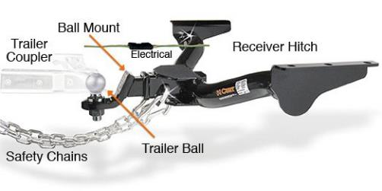
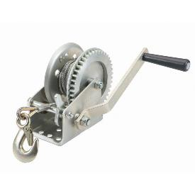
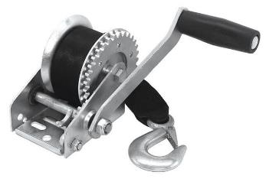
Trailer Equipment
Hitch
Winch
Notes:
1. Hitches.
a. The trailer is attached to the towing vehicle by a trailer hitch. A socket on the front of the trailer drops over a ball on the back of the hitch and then locks down. These two parts must match in size. The ball size is determined by the class of trailer. The size rating will be stamped on the ball. On the trailer the size will be stamped on the coupler. The hitch should be permanently attached to the towing vehicle and should handle the load you are attempting to pull. Frame-mounted hitches reduce trailer swaying. If using a vehicle bumper mounted hitch, do not exceed the weight rating of the bumper.
b. Tongue weight is the weight the loaded trailer places on the towing hitch. The tongue weight should be 7 - 10% of the combined weight of the boat and trailer. If the tongue weight is too low, the trailer will fishtail at high speed. If the tongue weight is too high, it will drag down the rear of the tow vehicle and make steering difficult.

Slide 7
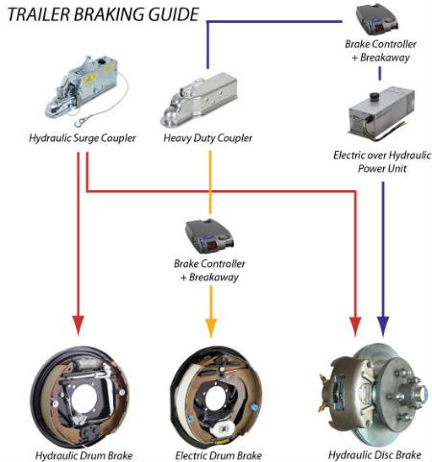
Trailer Equipment
Brakes
Notes:
Lights - All trailers should be equipped with lights as required by law. These lights should be waterproof and mounted up high on the trailer if possible. It is a good idea to unplug the lights before backing the trailer into the water, but remember to plug them back in after the trailer is out of the water.
Transom Saver - Many trailers utilize a motor support or transom saver to help support outboard engines and keep the engine from bouncing and cracking or breaking the transom.
Supports - All trailers have some type of bottom support on which the vessel rests and which helps support and distribute the weight of the vessel over the trailer. These supports may include carpet-covered wood runner and rubber rollers. Trailers may also be outfitted with a variety of side guides.

Slide 8
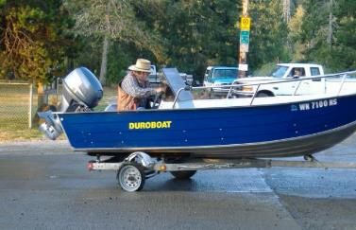
Trailer Equipment
Tires:
Trailer tires require special attention
Chances are good they will rot of old age before
the treads are gone
Number one enemy is heat. Watch for spiderweb
cracking on the sidewalls
Check manufactured date on sidewall when purchasing
Tire life usually less than 5 years
Notes:
Tires should be checked for proper inflation as well as age. Ensure tires are not dry rotting.
Always have a SPARE!

Slide 9
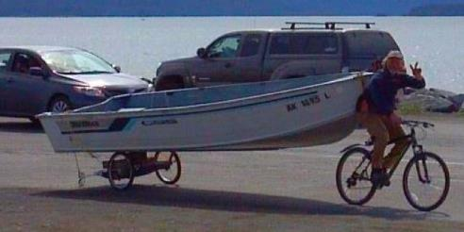
Towing Vehicle
Proper Size and Power
Transmission designed for towing (transmission cooler)
Heavy-duty brakes
Mirrors
Load bearing hitch attached to the frame (not the bumper)
Tires
Notes:
Choosing the correct tow vehicle for the job requires knowing the load rating and what equipment is available on the tow vehicle.
A. Check the manufacturer’s load rating on the bumper and trailer ball. Ensure that you know how additional add on’s, such as stabilizers, weight distribution hitches and drop down hitches, affects the load rating of the towing vehicle.
B. Equipment.
1. Hitch. The trailer is attached to the towing vehicle by a trailer hitch. A socket on the front of the trailer drops over a ball on the back of the hitch and then locks down. These two parts must match in size. The ball size is determined by the class of trailer. The size rating will be stamped on the ball. On the trailer the size will be stamped on the coupler. The hitch should be permanently attached to the towing vehicle and should handle the load you are attempting to pull. Frame-mounted hitches reduce trailer swaying. If using a vehicle bumper mounted hitch, do not exceed the weight rating of the bumper.
2. If a heavy trailer is to be pulled, you may need to add a cooler for crankcase oil and transmission fluid. Check the vehicle owner’s manual to determine the maximum load that can be towed without modifications to ensure that you do not void the vehicle’s warranty.
3. The towing vehicle should have sufficient horsepower to tow the weight of the trailer and boat.
Rule of Thumb: Add the weight of the boat and trailer.
Knock off the last zero.
The remainder equals how many cubic inches of engine you need to adequately haul the load.
4. Make sure your side view mirrors are large enough to provide an unobstructed rear view on both sides of the vehicle.
5. Tires on the towing vehicle should be properly inflated with good tread.

Slide 10
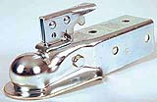
Hitching Up
Socket on the trailer drops over the ball on the hitch
Size determined by the class (weight) of trailer
Safety Pin or Locking Mechanism
Lights
Trailer brakes
Safety Chains

Slide 11
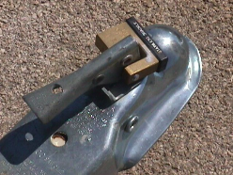
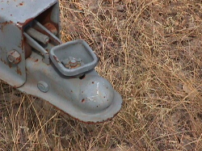
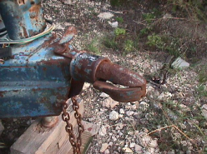
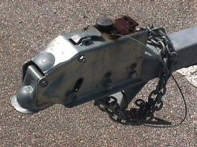
Hitch Types
Lever
Screw
Inertia
over
Hydraulics
Bulldog

Slide 12
Safety Chains
Criss-cross chains under the coupler to the frame of the vehicle
The opening of the S-hook should point towards the boat, away from the vehicle
Notes:
Safety chains should be a part of every hitch system. The chains should have a breaking strength of no less than the combined weight of the boat and trailer.
The safety chains are attached crisscrossing under the coupler to the frame of the tow vehicle. If the ball were to break, the trailer would follow in a straight line and prevent the coupler from dragging on the road.
The opening of the S-hook should point towards the boat, away from the vehicle. This helps the hook to stay attached if it bounces up.

Slide 13
Balance the Weight
Too much weight on the rear of the trailer will cause the trailer to fishtail and may reduce traction or lift the rear wheels of the tow vehicle off the ground.
Too much weight on the hitch will cause the rear wheels of the tow vehicle to drag and may make steering more difficult.

Slide 14
Safety Checks
The driver is responsible!!!
The tow ball and coupler are the same size
The coupler is completely over the ball and the latching mechanism is locked.
Safety chains are crossed and securely attached.
Safety catch/chain is secured to bow of vessel.

Slide 15
Safety Checks
The driver is responsible!!!
Tie-downs are secured at the stern of the boat.
Trailer lights are securely plugged in to the towing vehicle.
Check brake lights and turn signals for proper operation.
Check transom saver if applicable.

Slide 16
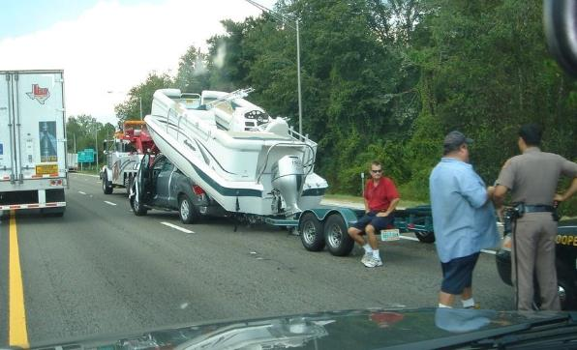
Towing Tips
Allow more time to brake, accelerate, pass and stop.
Turning radius is greater than normal.
Check trailer, hitch, chain, tires, lights, gear after 100 miles.
Watch the trailer in the rear-view mirror and listen for unusual noises.
Practice!

Slide 17
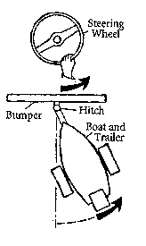
Backing Hint
While grasping the bottom of the steering wheel, move your hand in the direction you want the trailer to go.

Slide 18
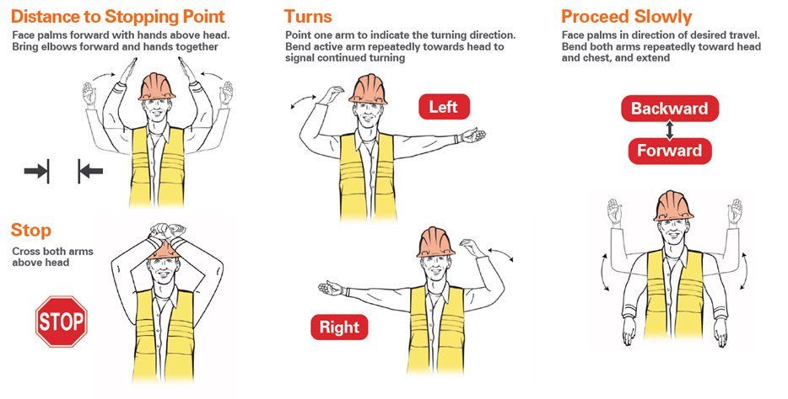
Backing Hand Signals

Slide 19
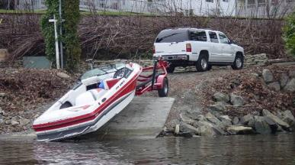
Launching
Before leaving home make sure the boat and trailer are fully operational
Prepare the boat for launching in an adjacent parking area
Don’t let a busy ramp rush you.
If you leave your vehicle set the parking brake, chock wheels, put transmission in “park”

Slide 20
Launching
Are the plug(s) in?
Unhook lights if necessary
Tie-downs unhooked?
Undo seatbelt and lower window
Trailer lowered to the proper depth?
Someone to help
Check ramp conditions
Know the weather forecast

Slide 21
Trailer Maintenance
Tires – proper inflation, have a spare, check for dry rot
Brakes – check fluids and operation
Wheel Bearings –
Check frequently
Use waterproof grease
Carry an extra set

Slide 22
Trailer Maintenance
Guides and Supports
Winch
Tie-downs and Straps
Frame
Fenders

Slide 23
Review:
What equipment is required for safe trailering?
How should the safety chains be hooked to a
tow vehicle?
Should you unfasten your seatbelt when launching
a boat?
Name the safe trailering practices?
What are some the normal maintenance items you
should perform on a trailer?

